Slide 1
Convolutional Neural Networks
Manish Gupta
Visiting Faculty at ISB
Senior Applied Scientist at Microsoft, India
Adjunct Faculty at IIIT-H
Credits: Stanford CS224D course, CS231N Stanford course, Geoffrey Hinton’s course, http://deeplearning.net/tutorial

Slide 2
Today’s Agenda
ImageNet and visual recognition problems
Introduction to CNNs and applications
Technical details of a CNN

Slide 3
Today’s Agenda
ImageNet and visual recognition problems
Introduction to CNNs and applications
Technical details of a CNN

Slide 4
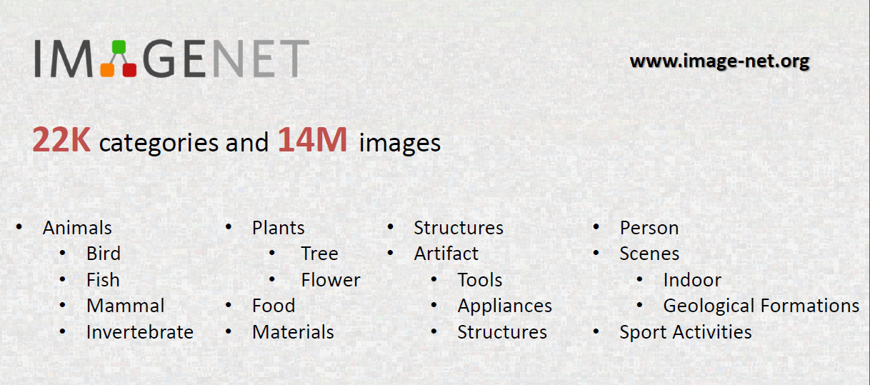
ImageNet
http://image-net.org/download-faq

Slide 5
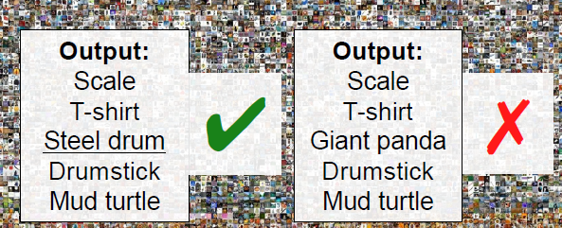
ImageNet Classification Challenge
1,000 object classes, 1,431,167 images

Slide 6
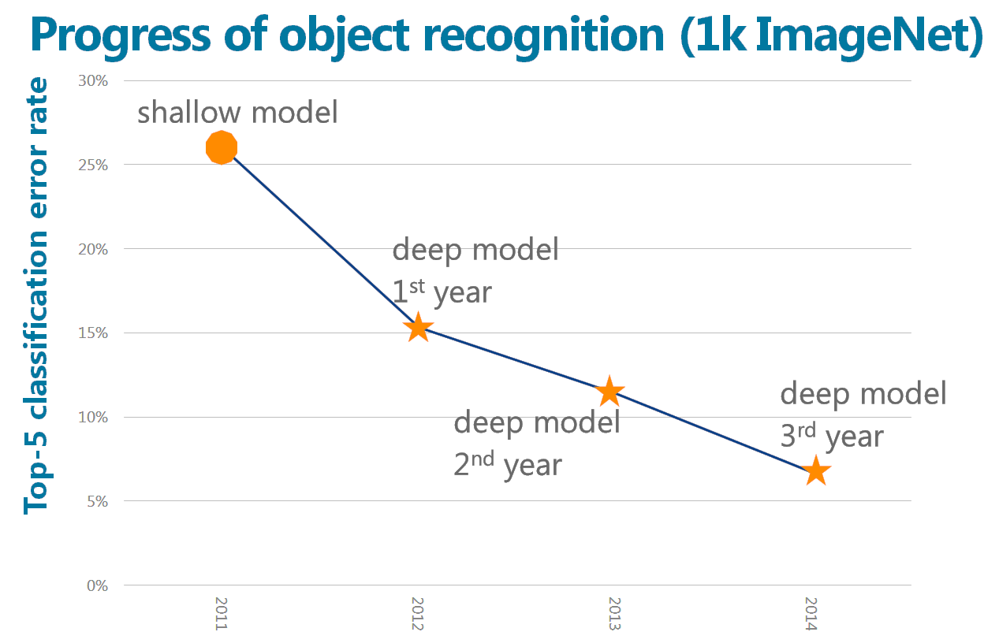


Year | 2010 | 2012 | 2014 | 2015 | 2016 | 2017
Model, Institution | Linear SVM, NEC-UIUC | AlexNet, SuperVision | Visual Geometry Group (VGG) Oxford, Googlenet | Resnet, MSRA | Trimps-Soushen, The Third Research Institute of the Ministry of Public Security, P.R. China. | Squeeze-and-Excitation Networks, NUS-Qihoo_DPNs (CLS-LOC)
#layers | Not a neural network | 8 layers | 22 layers | 152 layers | Ensemble of Inception-v3 (48 layers), Inception-v4 (~114 layers), Residual Network (152 layers), Inception-ResNet-v2 (200+ layers), Wide Residual Network (~16 layers) | Integrated SE blocks to stacked ResNet-152
Accuracy | 28% | 16% | 7% | 3.567% | 2.99% | 2.25%
4th year
Announced
Dec.2015
3.567%
3.581%
2012 - 2015
Super-deep: 152 layers

Slide 7
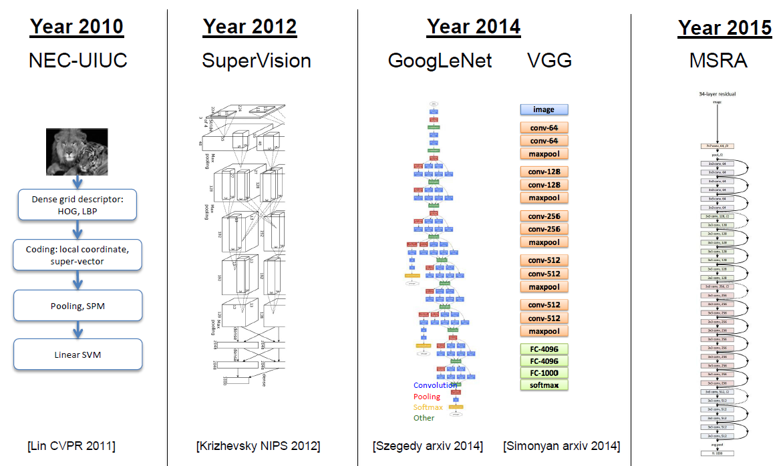
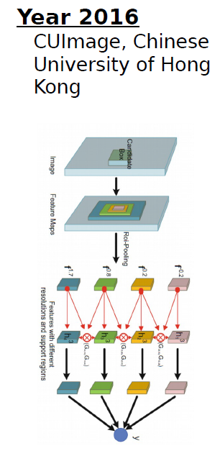
ImageNet Challenge Winning Architectures
Gated Bi-directional CNN: 269 layers
7 layers
27 layers
151 layers

Slide 8
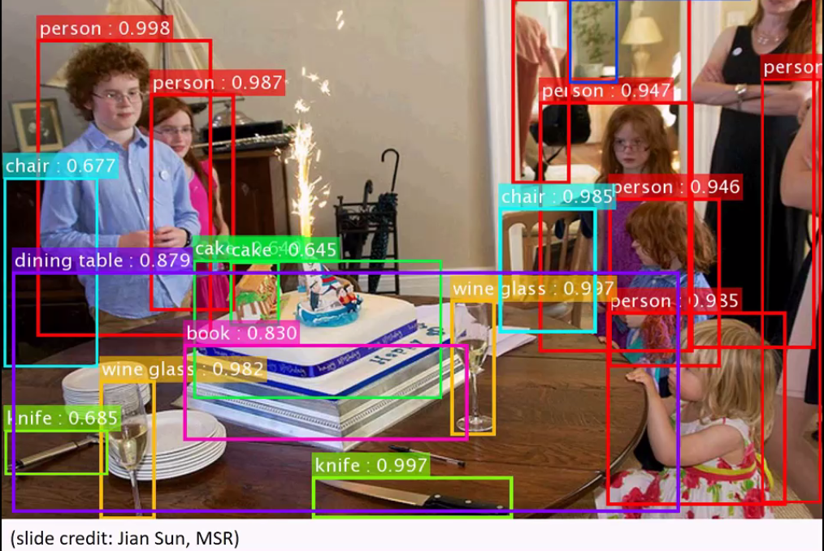

Slide 9
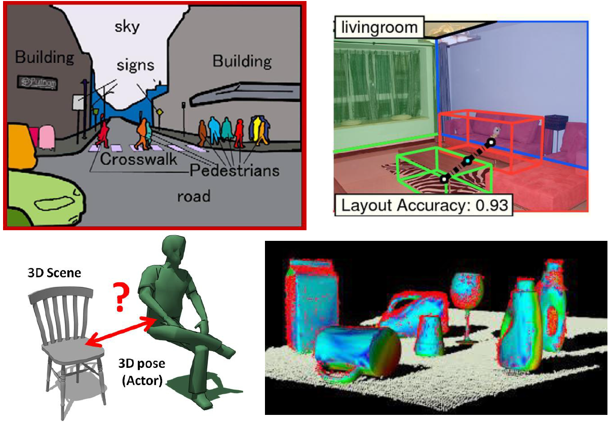
More difficult vision problems

Slide 10
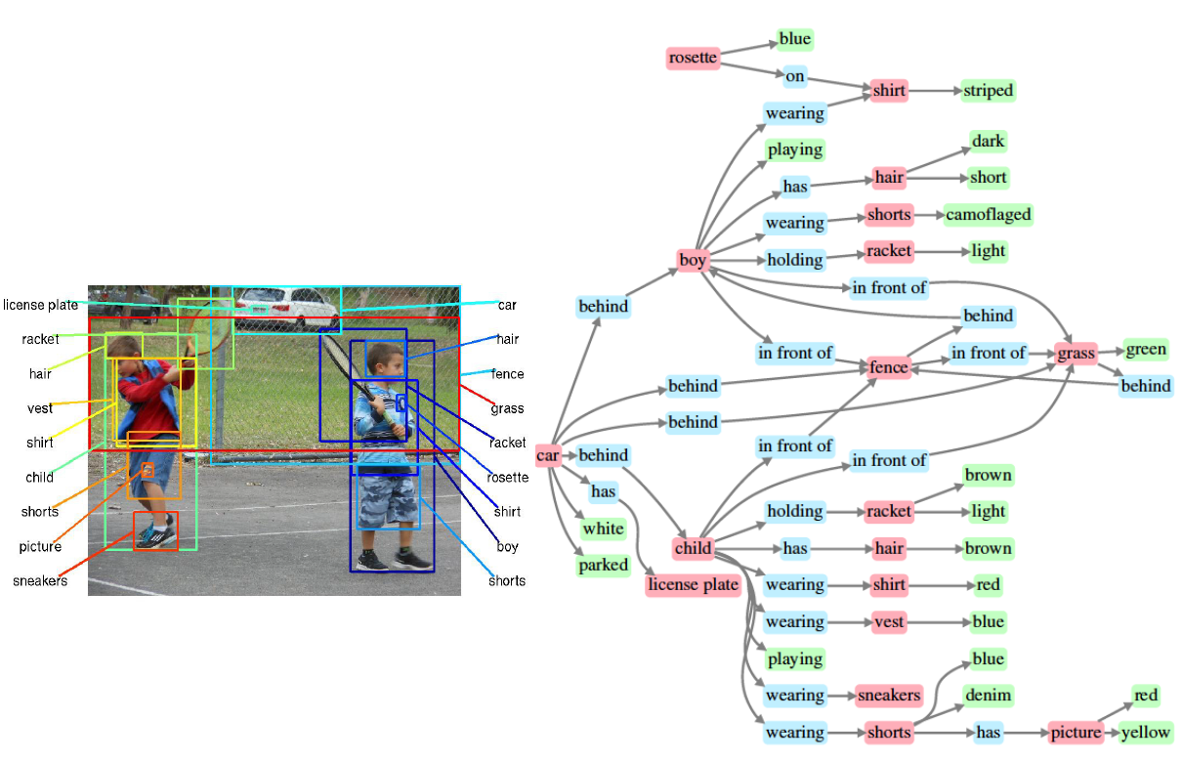
More difficult vision problems

Slide 11
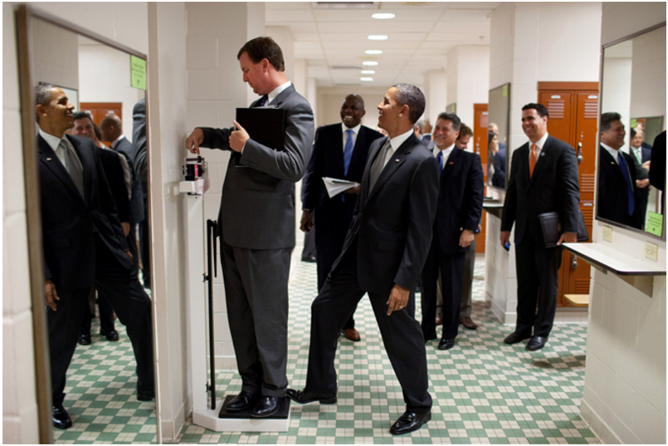
More difficult vision problems http://karpathy.github.io/2012/10/22/state-of-computer-vision/
You recognize it is an image of a bunch of people and you understand they are in a hallway
You recognize that there are 3 mirrors in the scene so some of those people are “fake” replicas from different viewpoints.
You recognize Obama from the few pixels that make up his face. It helps that he is in his suit and that he is surrounded by other people with suits.
You recognize that there’s a person standing on a scale, even though the scale occupies only very few white pixels that blend with the background. But, you’ve used the person’s pose and knowledge of how people interact with objects to figure it out.
You recognize that Obama has his foot positioned just slightly on top of the scale. Notice the language I’m using: It is in terms of the 3D structure of the scene, not the position of the leg in the 2D coordinate system of the image.
You know how physics works: Obama is leaning in on the scale, which applies a force on it. Scale measures force that is applied on it, that’s how it works => it will over-estimate the weight of the person standing on it.
The person measuring his weight is not aware of Obama doing this. You derive this because you know his pose, you understand that the field of view of a person is finite, and you understand that he is not very likely to sense the slight push of Obama’s foot.
You understand that people are self-conscious about their weight. You also understand that he is reading off the scale measurement, and that shortly the over-estimated weight will confuse him because it will probably be much higher than what he expects. In other words, you reason about implications of the events that are about to unfold seconds after this photo was taken, and especially about the thoughts and how they will develop inside people’s heads. You also reason about what pieces of information are available to people.
There are people in the back who find the person’s imminent confusion funny. In other words you are reasoning about state of mind of people, and their view of the state of mind of another person. That’s getting frighteningly meta.
Finally, the fact that the perpetrator here is the president makes it maybe even a little more funnier. You understand what actions are more or less likely to be undertaken by different people based on their status and identity.

Slide 12
Today’s Agenda
ImageNet and visual recognition problems
Introduction to CNNs and applications
Technical details of a CNN

Slide 13
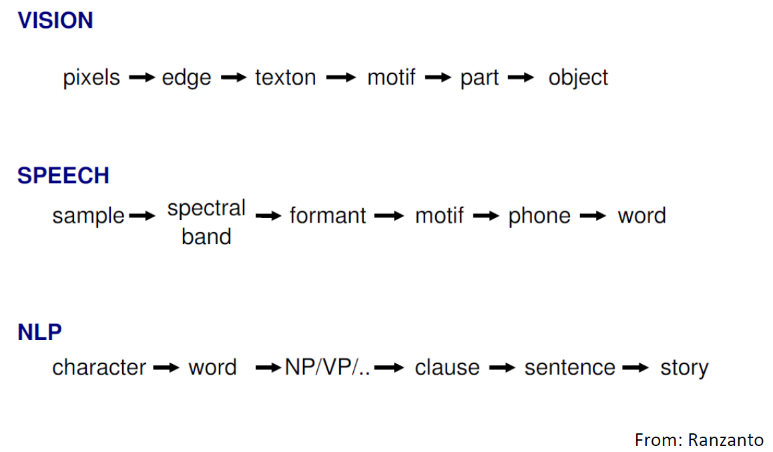
Hierarchical Approach

Slide 14
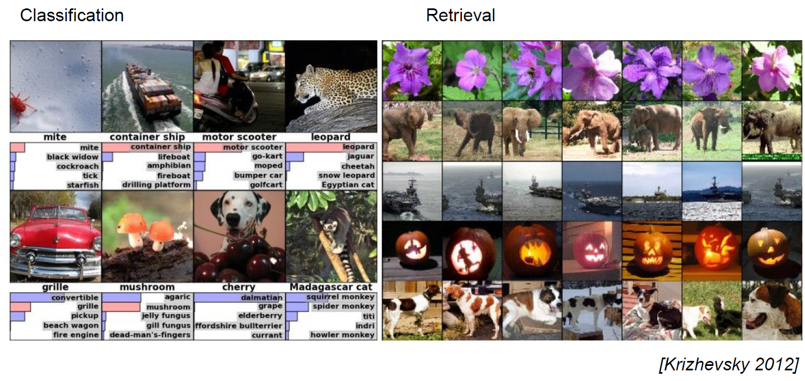
Convolution Networks are everywhere now

Slide 15
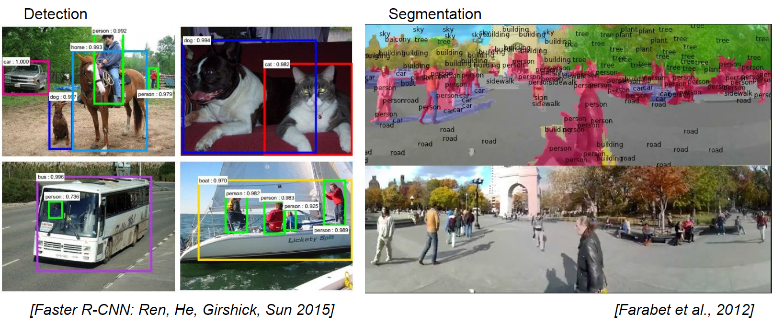
Convolution Networks are everywhere now

Slide 16
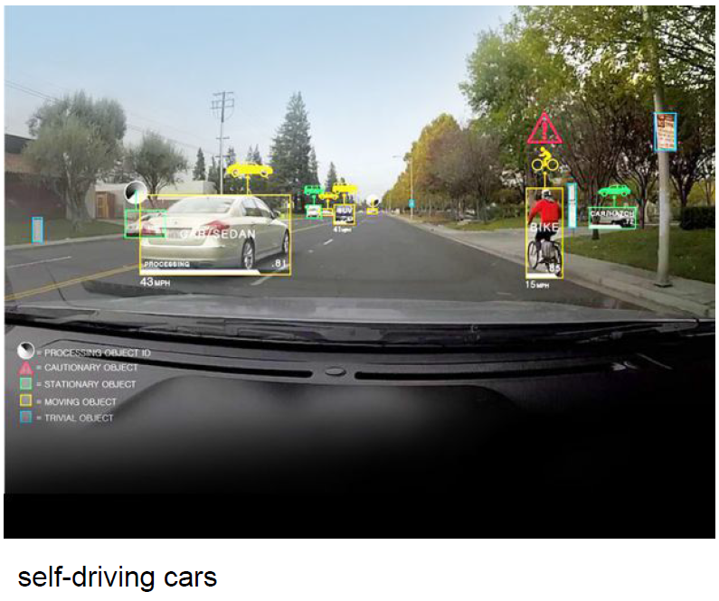
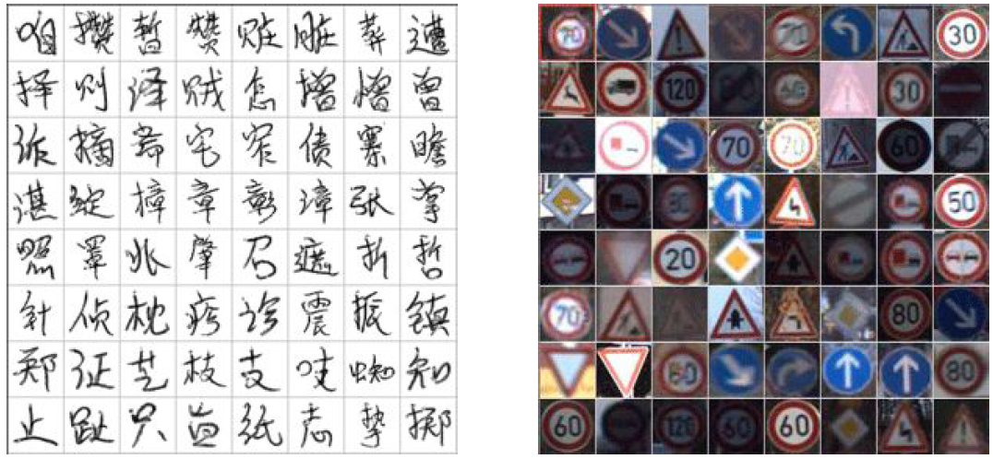
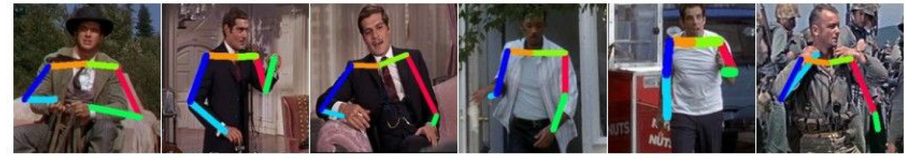
Convolution Networks are everywhere now

Slide 17
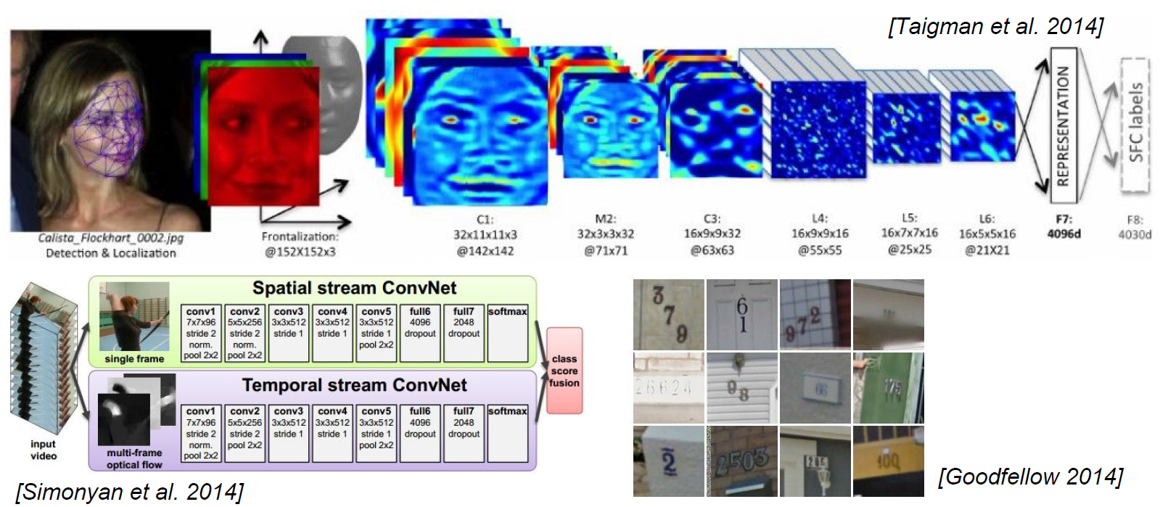
Convolution Networks are everywhere now

Slide 18
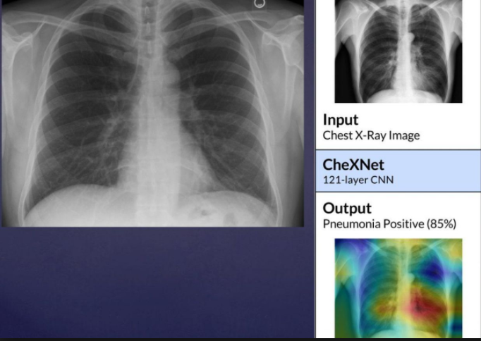
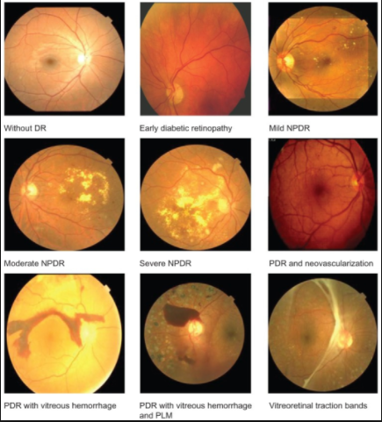
CNNs in healthcare

Slide 19
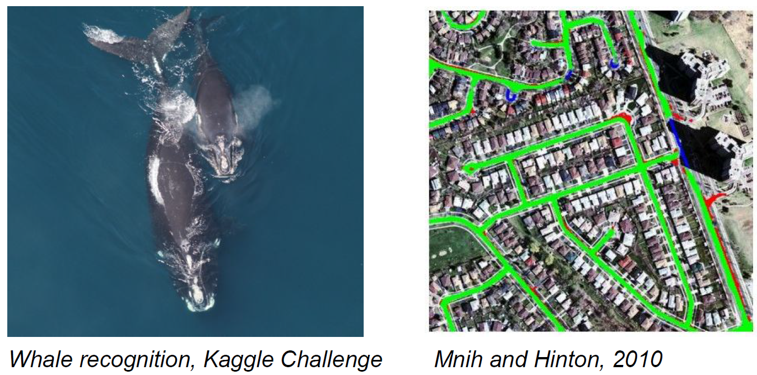
Convolution Networks are everywhere now

Slide 20
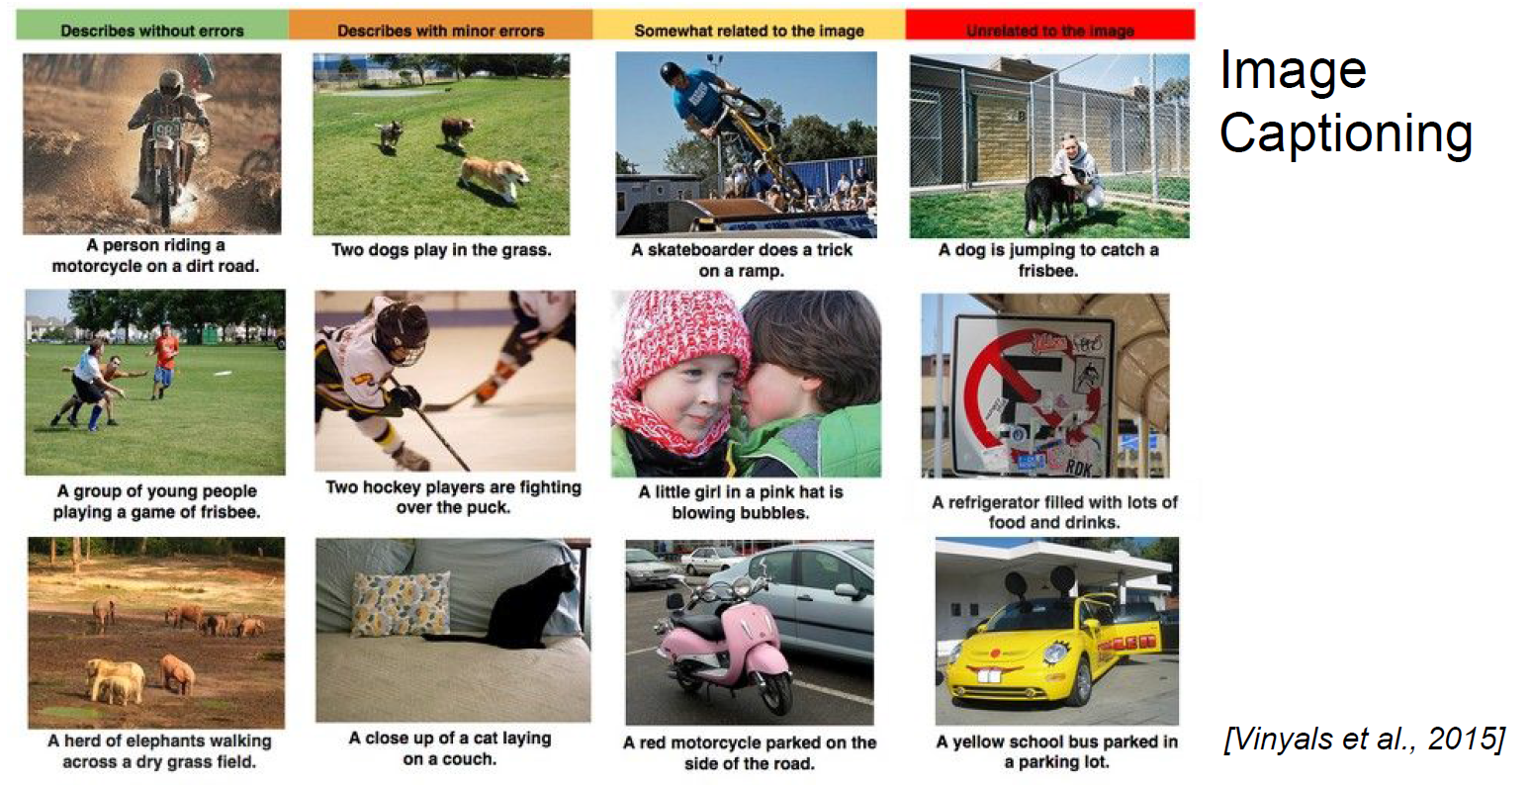
Convolution Networks are everywhere now

Slide 21
Classifying an image using MLPs?
In CIFAR-10 dataset, images are only of size 32x32x3 (32 wide, 32 high, 3 color channels), so a single fully connected neuron in a first hidden layer of a regular neural network would have 32*32*3 = 3,072 weights.
A 200x200 image, however, would lead to neurons that have 200*200*3 = 120,000 weights.
Such network architecture does not take into account the spatial structure of data, treating input pixels which are far apart and close together on exactly the same footing.
Clearly, the full connectivity of neurons is wasteful in the framework of image recognition, and the huge number of parameters quickly leads to overfitting.

Slide 22
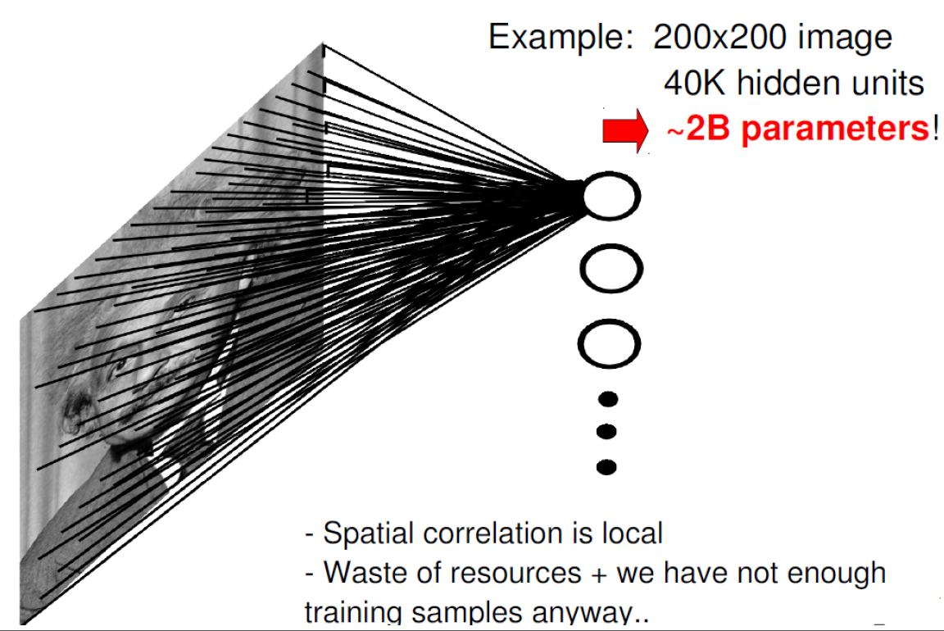
Parameter explosion with MLPs

Slide 23
Today’s Agenda
ImageNet and visual recognition problems
Introduction to CNNs and applications
Technical details of a CNN

Slide 24
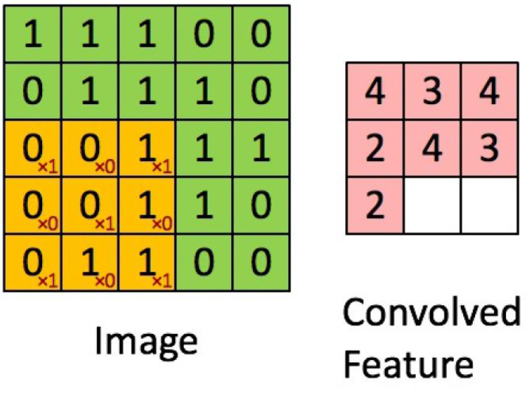
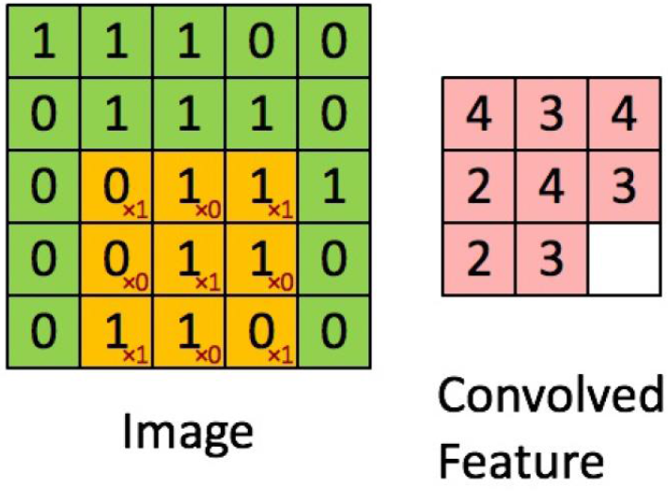
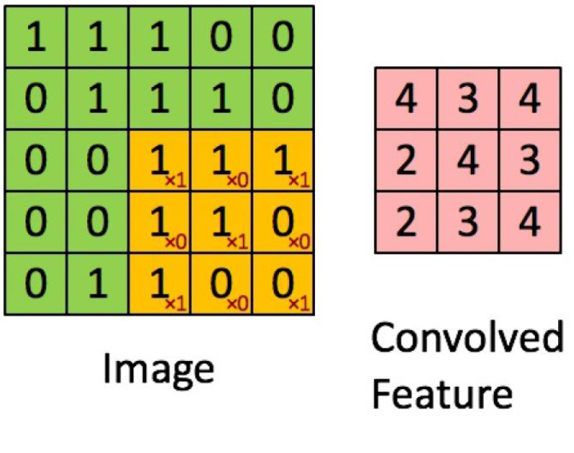
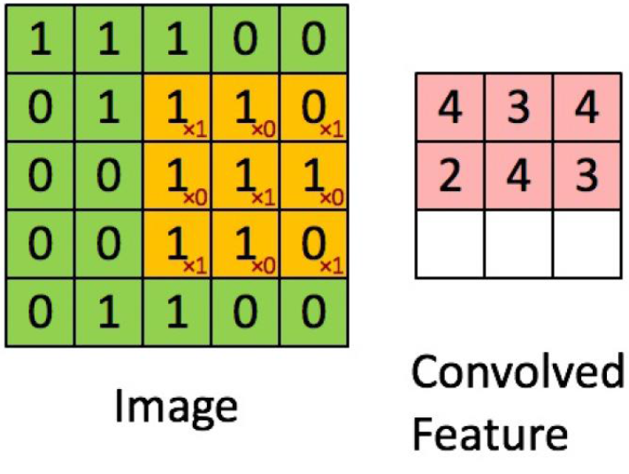
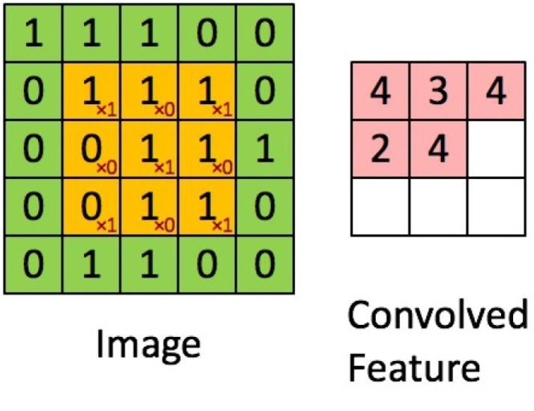
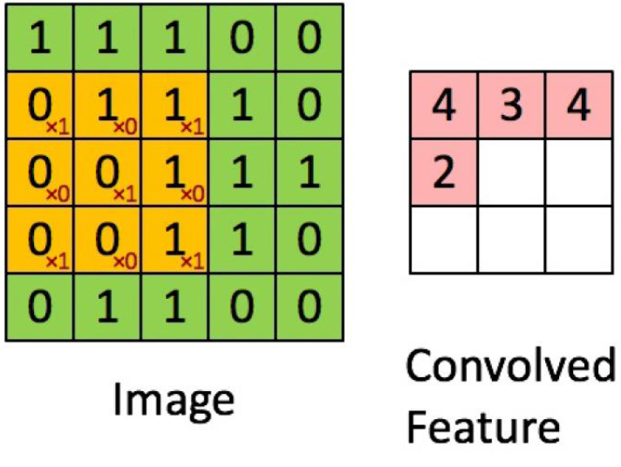
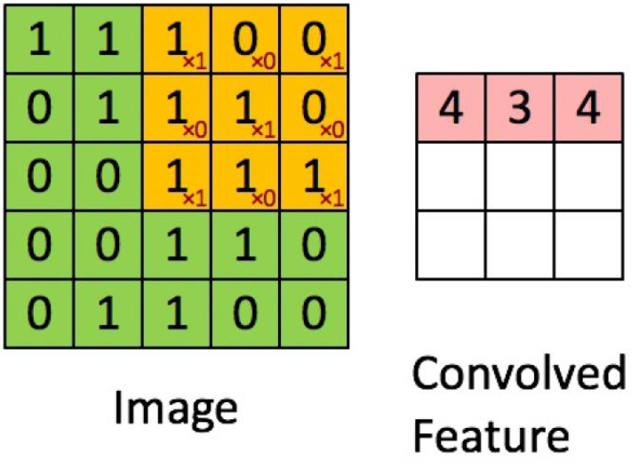
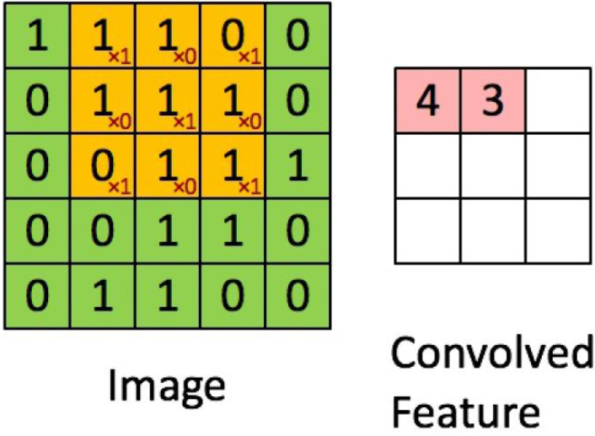
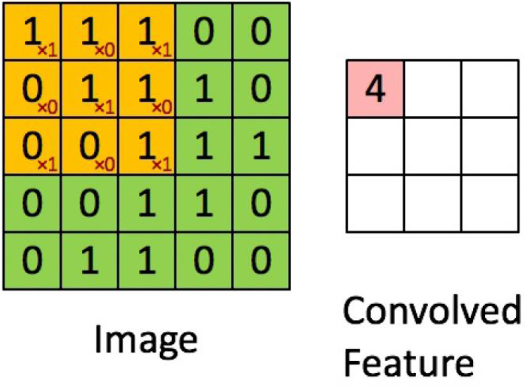
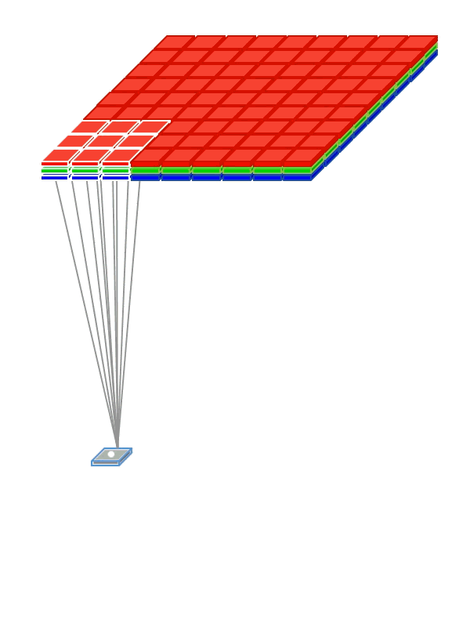
What is convolution of an image with a filter?

Slide 25
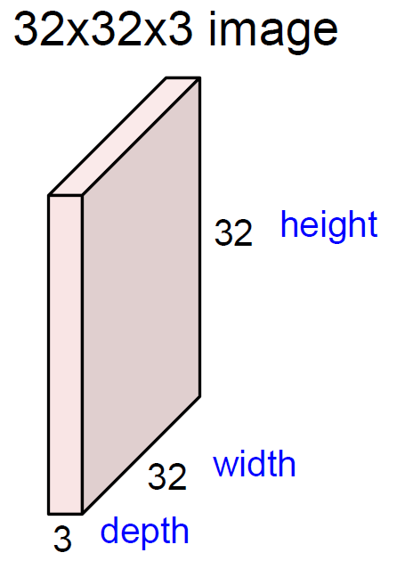
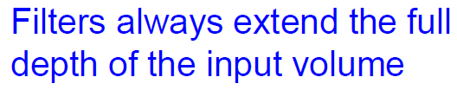
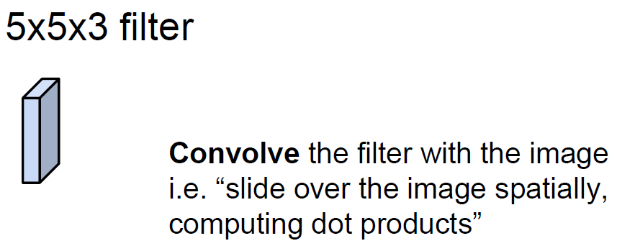
Convolution Layer

Slide 26
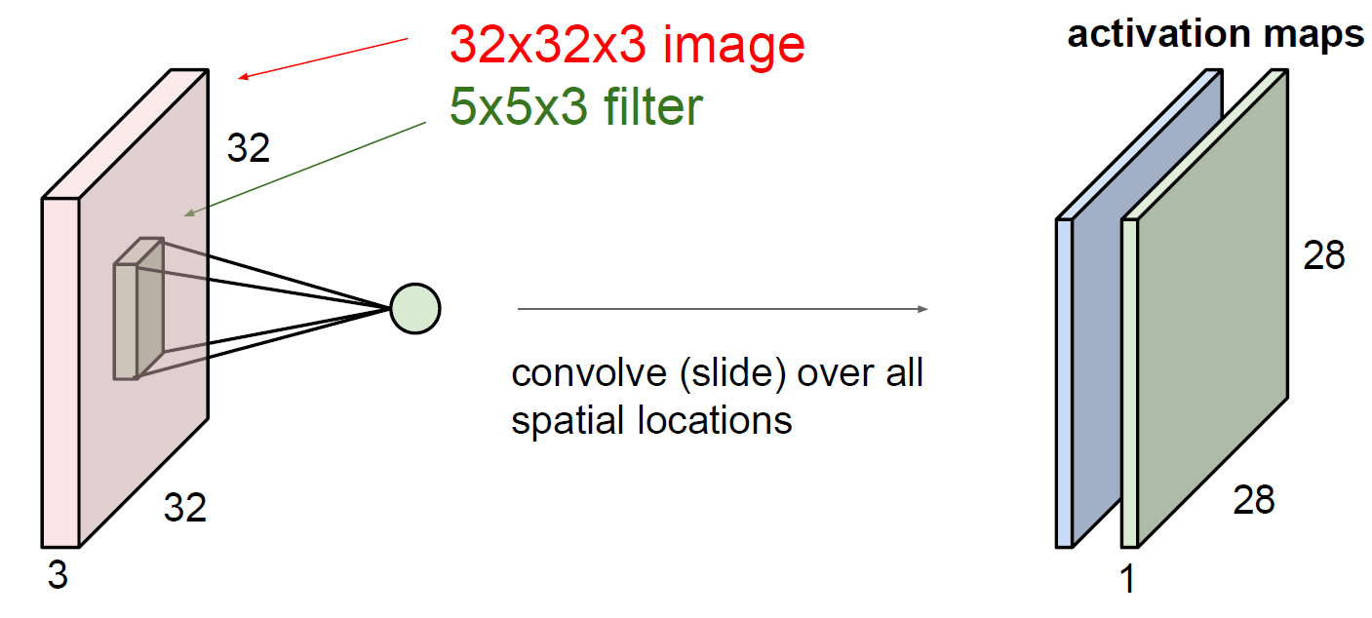
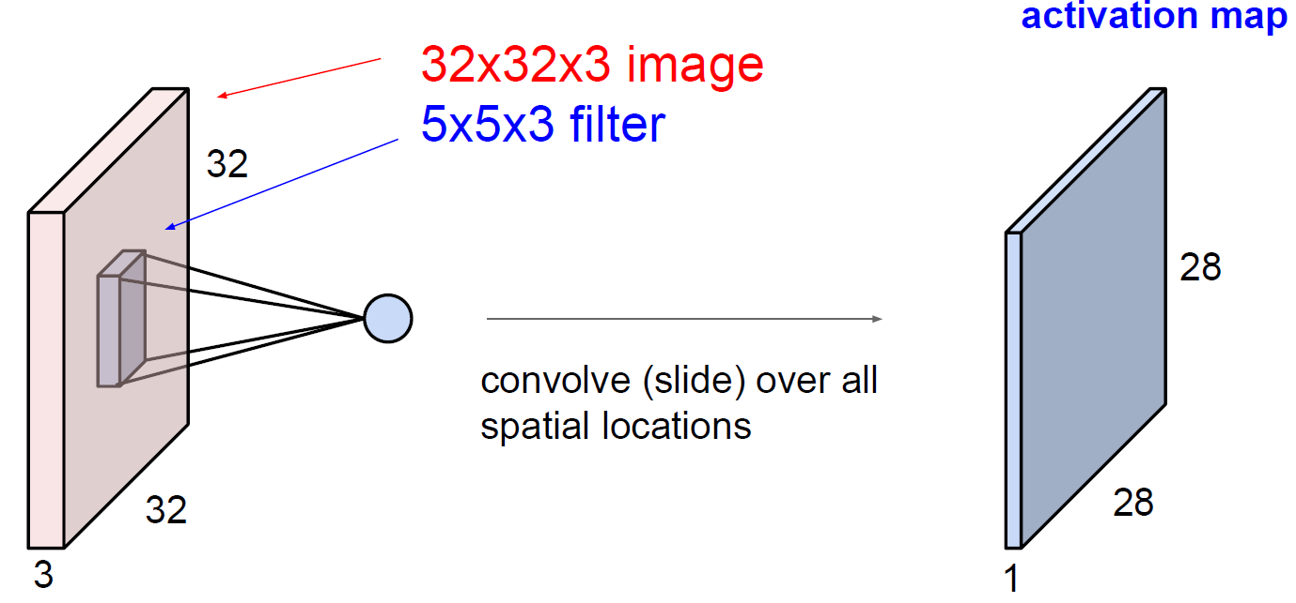
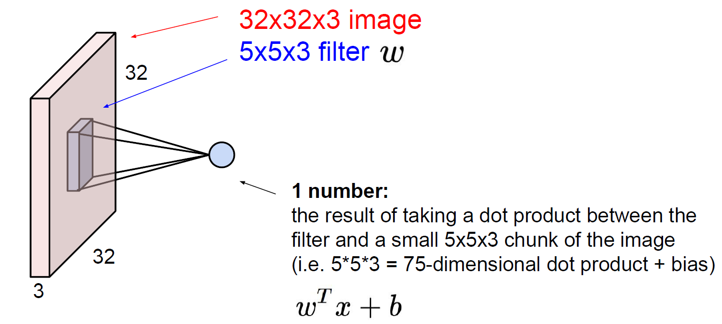
Convolution Layer
consider a second, green filter

Slide 27
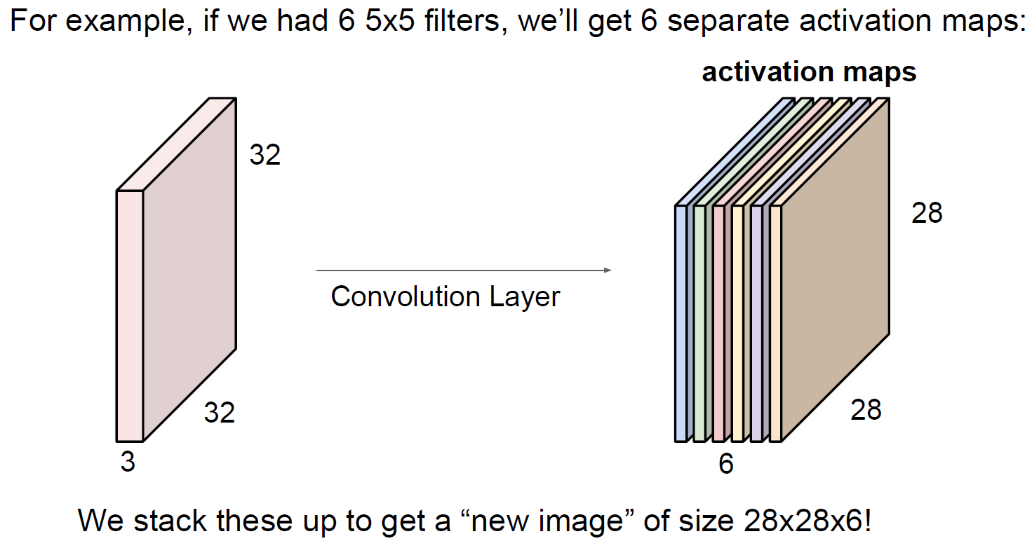
Convolution Layer

Slide 28
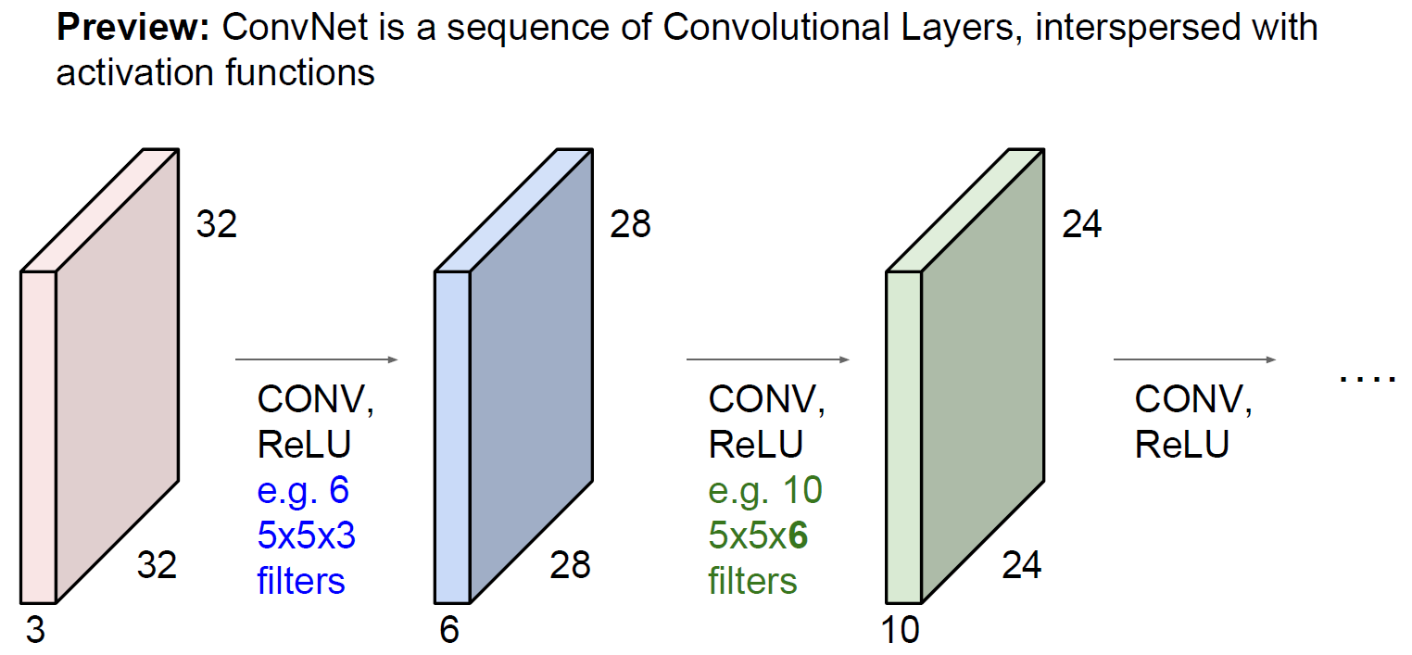
A Basic ConvNet

Slide 29

ConvNet with Pooling and FC Layers

Slide 30
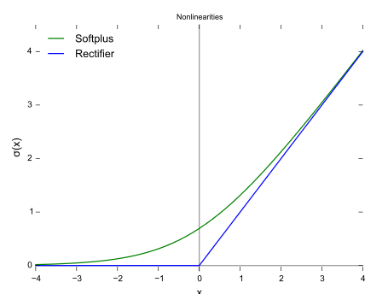
ReLU (Rectified Linear Units) Layer
This is a layer of neurons that applies the activation function f(x)=max(0,x).
Other functions are also used to increase nonlinearity, for example the hyperbolic tangent f(x)=tanh(x), and the sigmoid function.
This is also known as a ramp function.

Slide 31
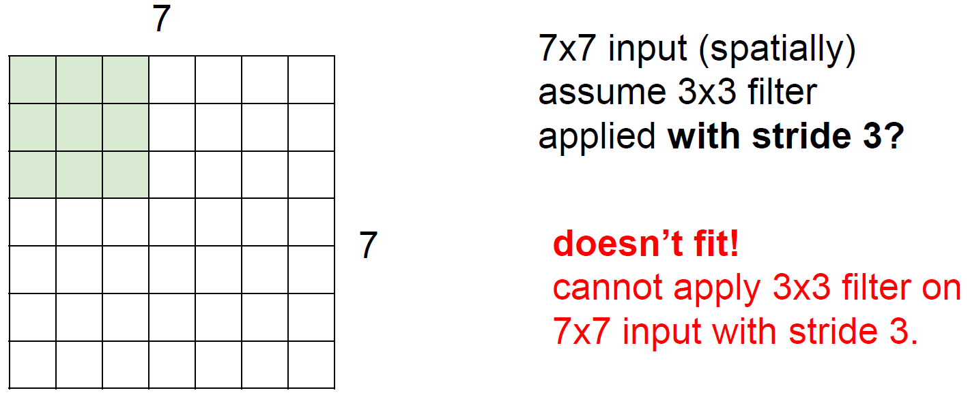
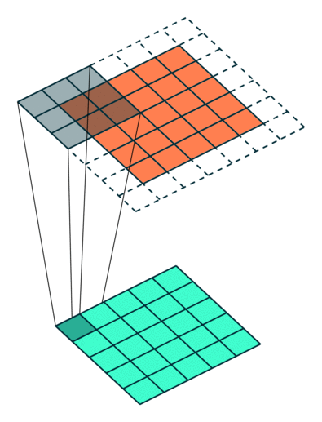
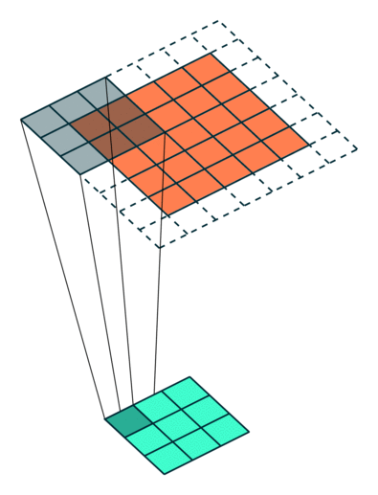
Details about the convolution layer
Stride=2
Stride=1

Slide 32
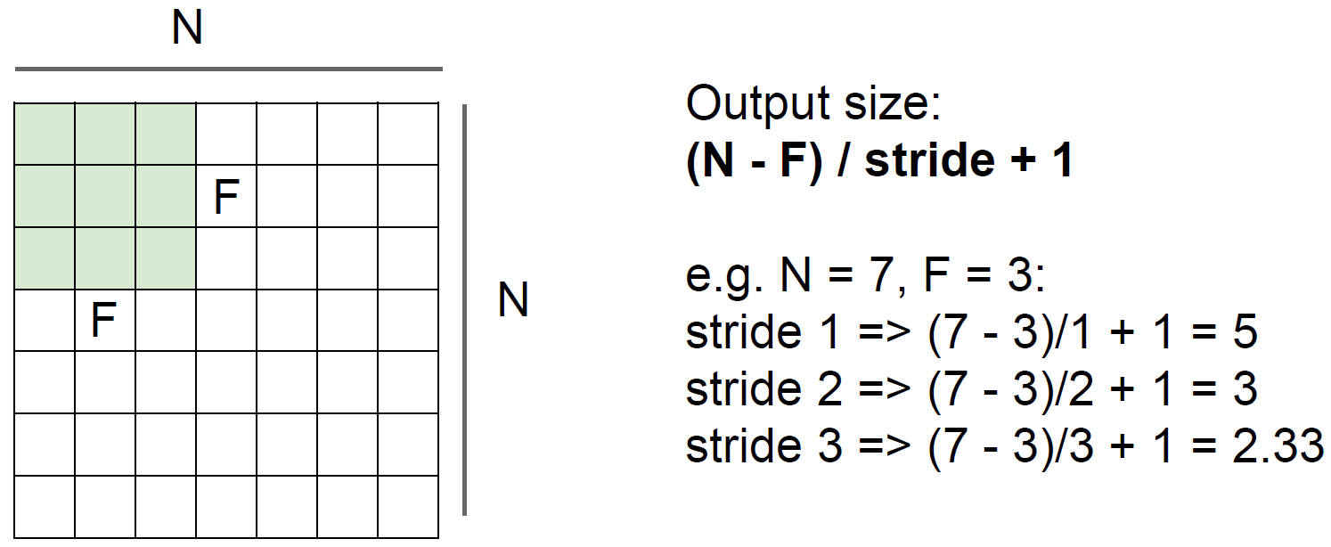
Details about the convolution layer

Slide 33
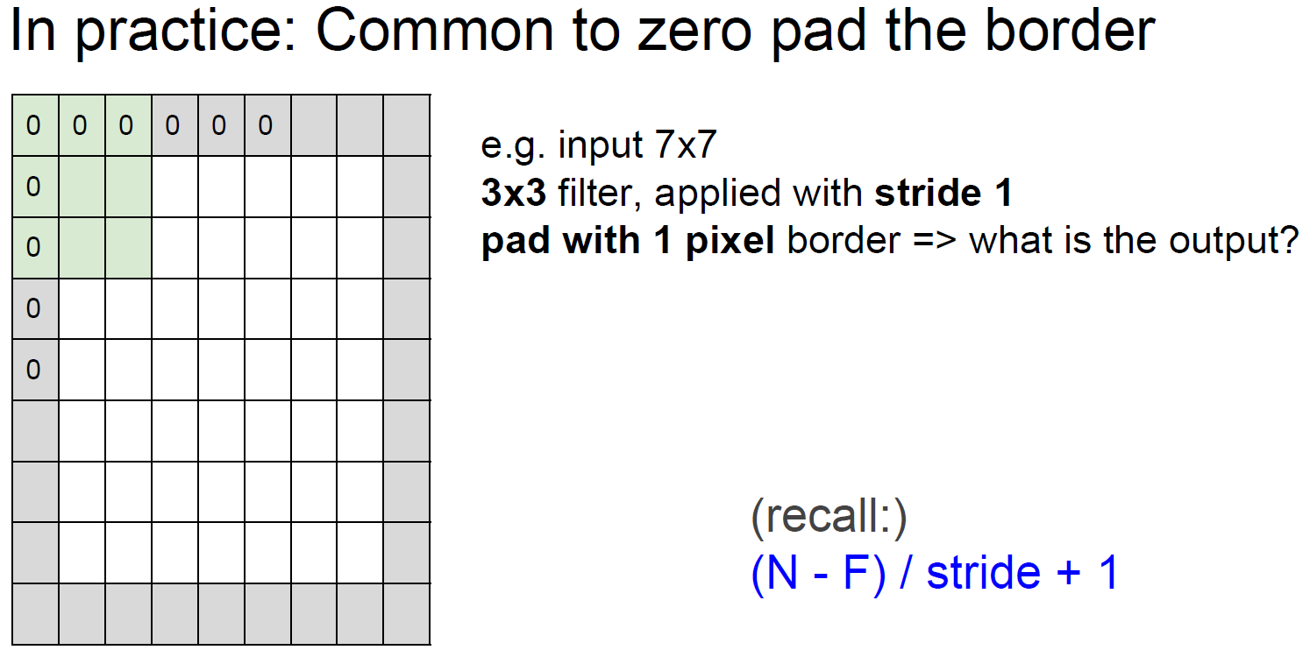
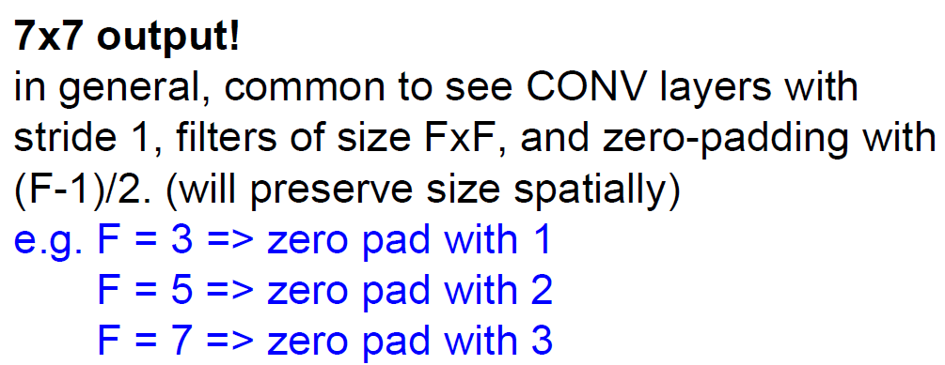
Details about the convolution layer

Slide 34
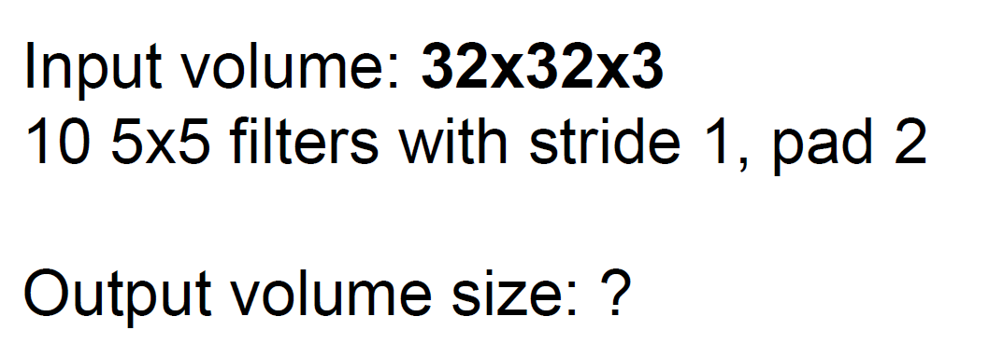
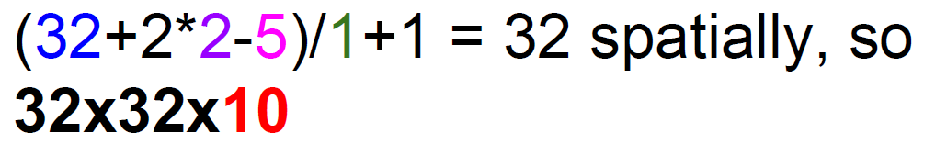
Convolution layer examples

Slide 35
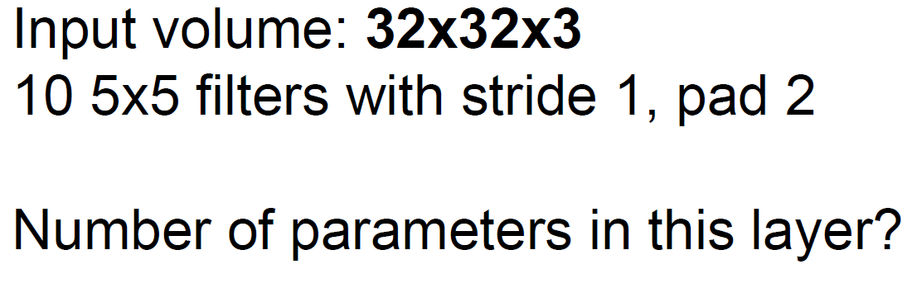
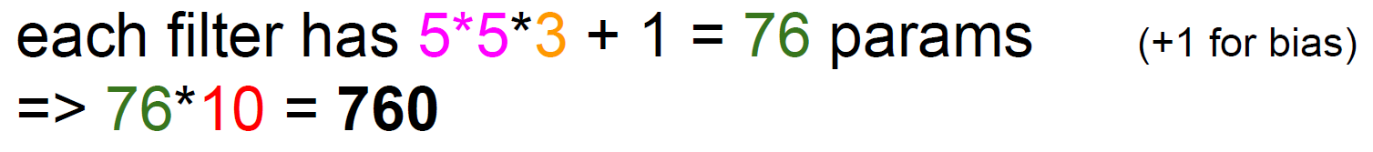

Convolution layer examples

Slide 36


Neuron view of the convolution layer

Slide 37

Neuron view of the convolution layer

Slide 38
ConvNet with Pooling and FC Layers

Slide 39




Pooling Layer

Slide 40


Average and Max Pooling
Average Pooling
Max Pooling

Slide 41

Fully Connected Layer

Slide 42


Slide 43
Take-aways
CNNs are very popular these days across a large variety of tasks.
Convolution networks are inspired by the hierarchical structure of the visual cortex.
Things that differentiate CNNs from DNNs are Sparse connectivity, shared weights, feature maps and pooling.
CNN feature visualization: http://people.csail.mit.edu/torralba/research/drawCNN/drawNet.html?path=imagenetCNN

